Slide 1

Final PROJECT Calculator
By: Brian Marte

Slide 2
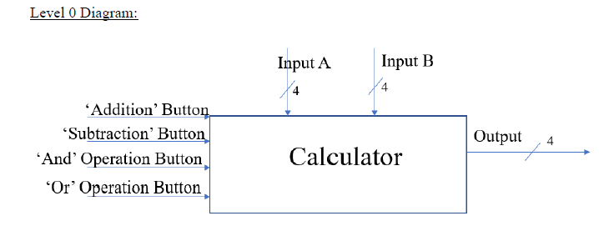
Calculator top level

Slide 3
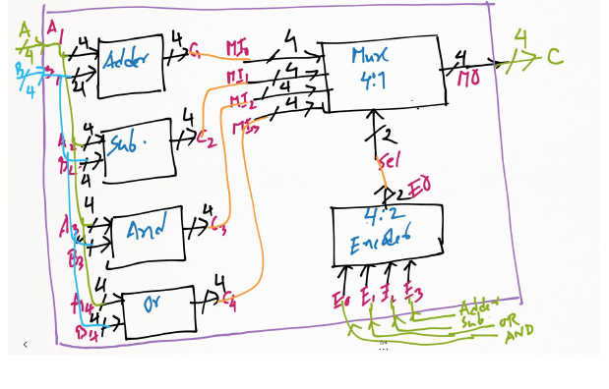
Calculator level 1

Slide 4
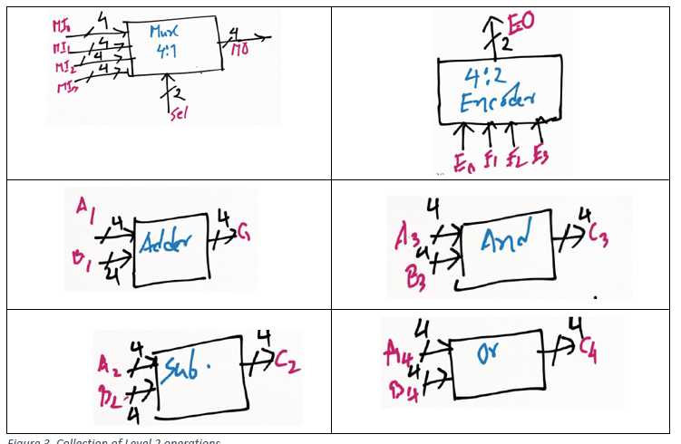
Calculator level 2

Slide 5
Links
GitHub - https://github.com/bmarte1028/CST223.git

